Slide 1

Automatic Street Light System
Microprocessor Systems & Interfacing (CPE342)
Group: Omama Mukhtar, Maryam Asif, Aliyan Ahmed
Roll Nos: FA22-BCE-051, FA22-BCE-014, FA22-BCE-028

Slide 2

Introduction
This project aims to create an intelligent automatic street light system using an ESP32 microcontroller. It detects ambient light using an LDR sensor and switches street lights ON/OFF accordingly. Bluetooth control allows manual override for remote activation. To demonstrate scalability, multiple LEDs are used to simulate lighting control for different rooms or sections.

Slide 3

Project Objectives
Automate street lighting based on real-time light levels.
Reduce energy consumption.
Enable manual control using Bluetooth.
Display current status on OLED screen.
Simulate control for multiple rooms/sections using individual LEDs.

Slide 4

Major Components Used
ESP32 Microcontroller
LDR Sensor
OLED Display (SSD1306)
Bluetooth Module (SerialBT)
Multiple LEDs (to represent different rooms/sections)
Breadboard, Power Supply, Wires

Slide 5

Circuit Logic Overview
Read LDR value to determine light level.
If dark, turn ON all/specific LEDs.
If bright, turn OFF all/specific LEDs.
Display status on OLED.
Bluetooth commands 'X'/'Y' override auto mode for 10 seconds and control all LEDs simultaneously.

Slide 6
Bluetooth Manual Override
Command 'X': Force all LEDs ON (Manual Mode).
Command 'Y': Force all LEDs OFF (Manual Mode).
Override timeout: 10 seconds.
Reverts back to LDR control after timeout.

Slide 7
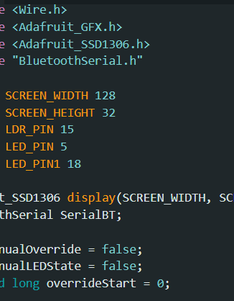
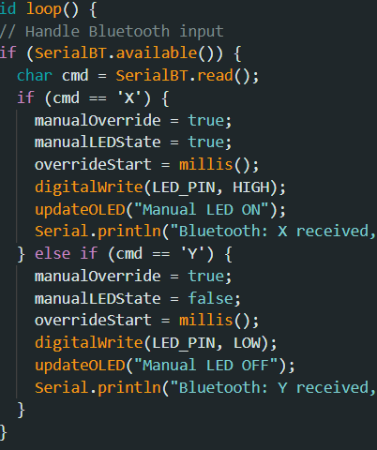
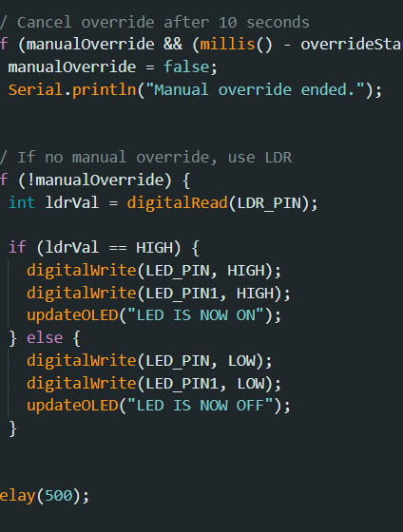
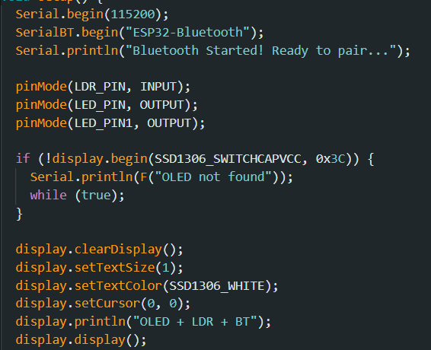
Code modules

Slide 8

OLED Display Function
Displays current system status:
'LEDs ARE NOW ON'
'LEDs ARE NOW OFF'
'Manual LEDs ON/OFF'
Helps in debugging and user feedback.

Slide 9
Conclusion
This system automates street lighting using sensor data and provides remote control features via Bluetooth. The use of multiple LEDs demonstrates how the system can be scaled to control lighting in different rooms or sections. It highlights efficient energy use, real-time monitoring, and embedded system integration.

Slide 10

Thank You
Questions & Feedback Welcome

